Slide 1
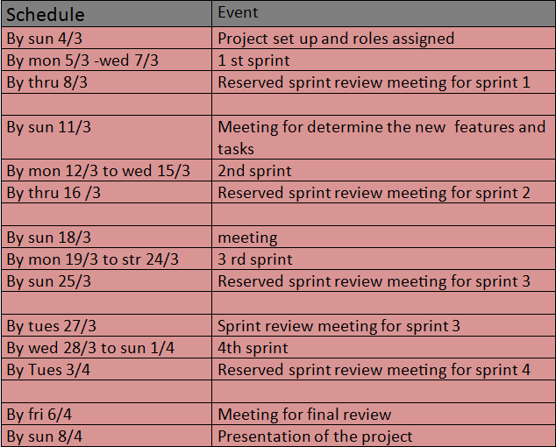
Table of content for the project plan
Table of content for the project plan
Project resource:
3-Planning schedule
1-stakeholders:
1-bassant mohamed.
2-heba anwer.
Bassant mohamed.
Heba anwer.
2-Tools and technology:
1-android.
2-asyn task thread.
3-sql.
4-php.

Slide 2
Study diary:
Roles & responsibilities:
1-product owner:
bassant mohamed.
Heba anwer.
2-scrum master:
Lap2&code implementation)) Mohamed anwer.
3-team member :
Data analysis&requirements ,lap1)) nermeen mohamed ali.
,Back log&lap1.) Story board) sara mohamed attia.
Planning Schedule &testing)) heba ghareeb mohamed.
Sketches)) ola elsayd.
(lap3&back end summery) manal taha.

Slide 3
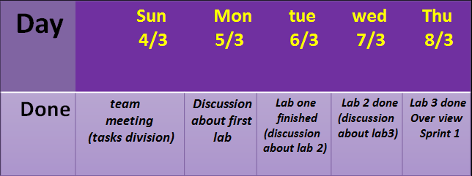
Sprint week1:

Slide 4
Risk management plan:
1- the shortest of the time required.
2- the available material.
3-arguments between
team members .
4- under standing the customer needs.
5- the limited budget.

